Slide 1

Session 1V
By
Alok Ranjan
Nikhil analytics

Slide 2
Agenda of Session 1V
Data Manipulations
Lambda functions, Map Functions, Reduce Functions, Filter functions, List comprehensions
Missing Value check and treatments
Outlier checks and treatments
Chi-Square Test

Slide 3

Data Manipulations
Lambda function - is used to create temporary function
#lambda args:calculation
Map() - is used to perform calculation on each value of list
#map(lambda , collection)
Filter - is used to filter given list based on condition
# filter(lambda , collection)
Reduce - is used to reduce list values to single value

Slide 4
Data Manipulations
Missing Value check and treatments
Outlier checks and treatments

Slide 5
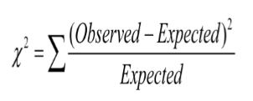
Chi-Square Test
Chi square test is used to find association between two categorical variables. The formula for chi square statistic is given below.

